Slide 1
Lakehouse in a Day

Slide 2
Why Lakehouse?

Slide 3
Maintaining Competitive Edge
Everyone is trying to do it, so you need to:
Do it Better
Do it Faster
Do More of it
All of these elements are enabled by a solid Data Platform

Slide 4
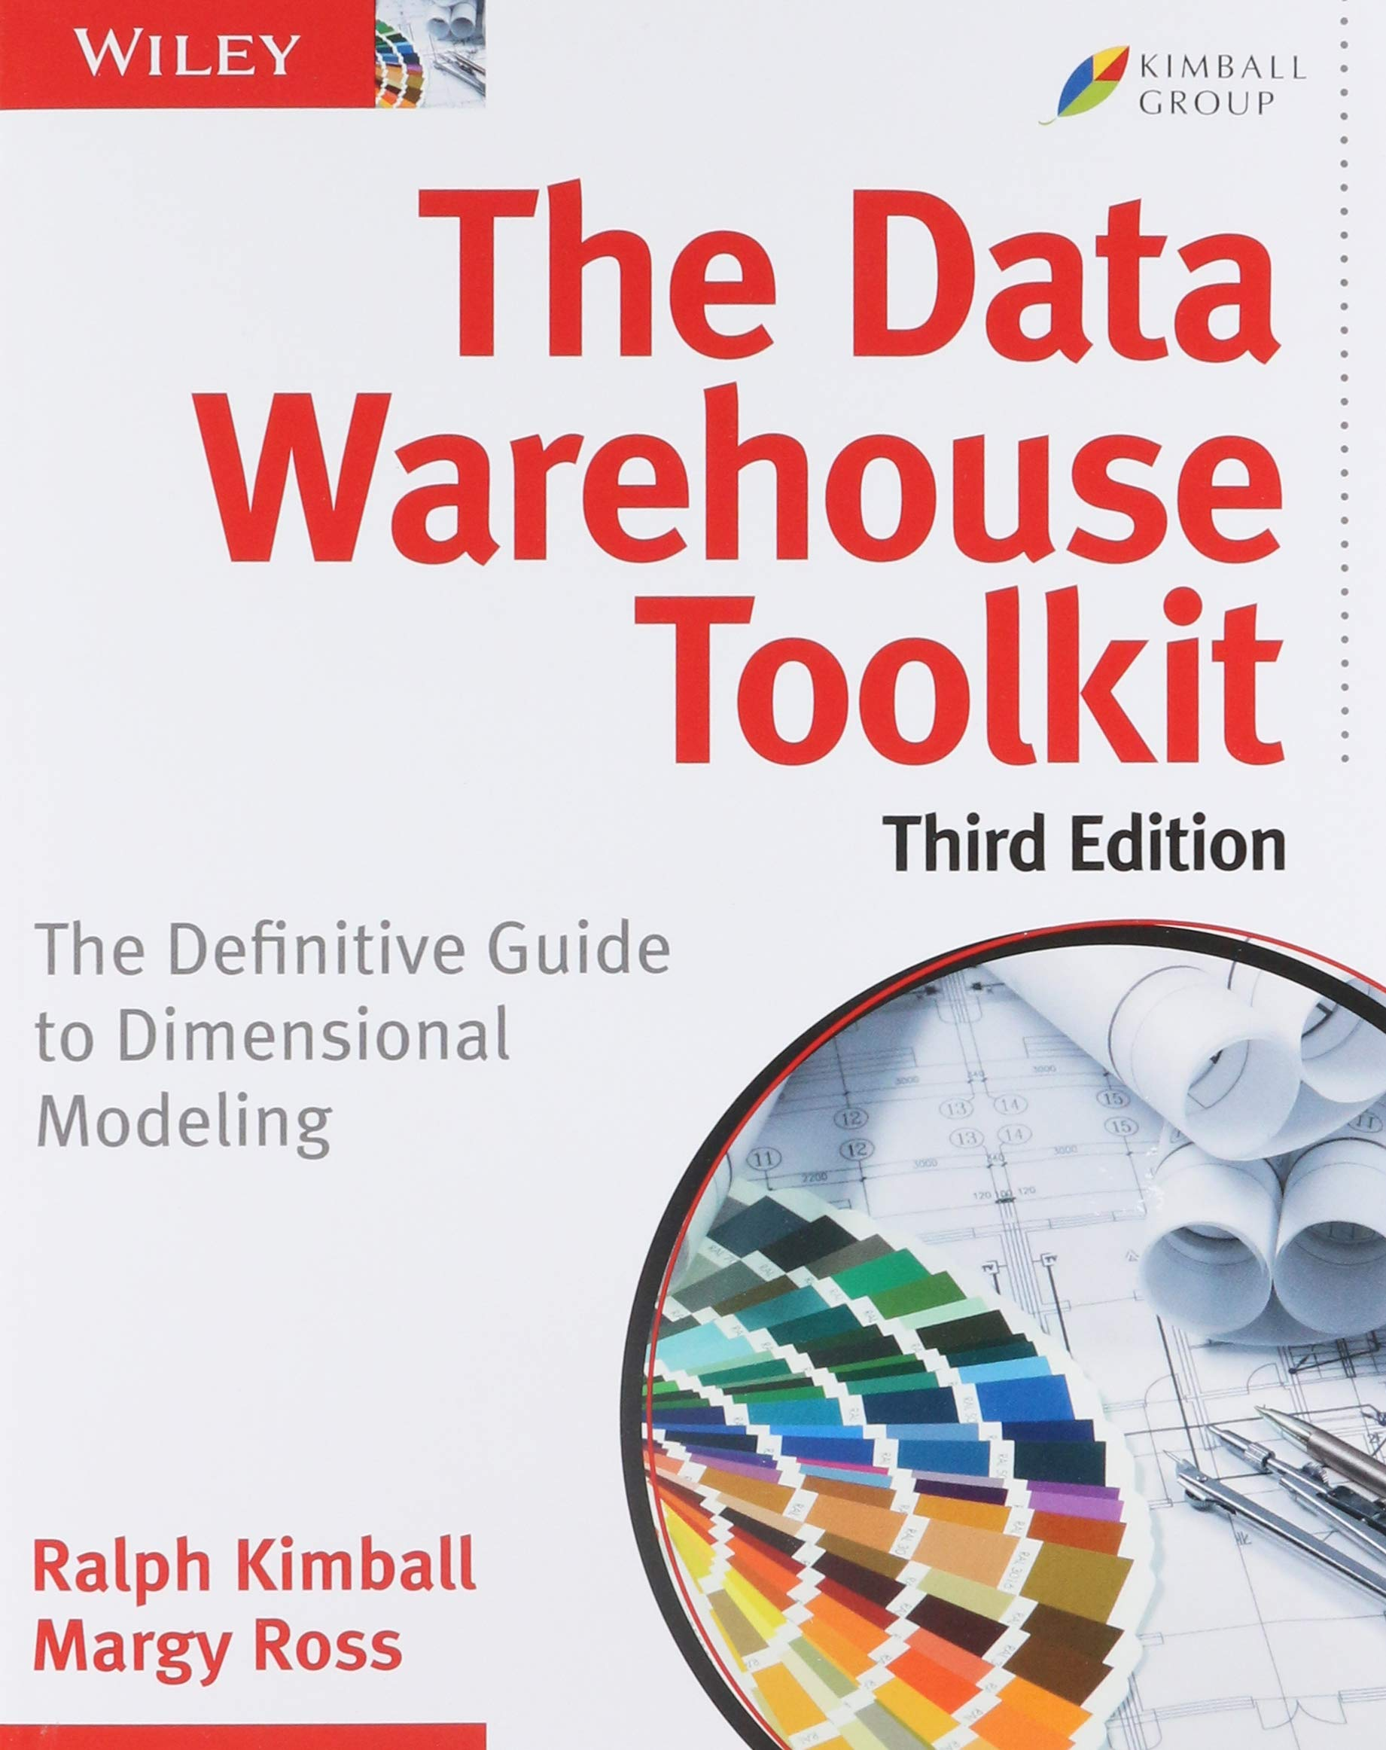
The Data Warehouse
Organisational Agility
Centralised Quality
Reporting Consistency
Data-Driven Decision Making
Competitive Advantage
Cross-Organisation View

Slide 6
Warehousing Pain-points
Expensive
Costly Upkeep
Structured Data Only
Slow to Change
Limited Advanced Capability

Slide 7
Data Lakes
Cost-Effective
Self-Managing
Big Data Compatible
Agility
Traditional & Advanced Analytics

Slide 8
The Downside of Lakes
Schema on Read
Operational Complexity
Governance
Auditable
Indexing
Small Files Problem
Traditional Lakes on their own cannot perform as an Enterprise-Ready Data Warehouse

Slide 9
The Modern Data Warehouse
Data Lake
Data Warehouse
Semantic
Layer

Slide 10
Delta Lake

Slide 11
Delta Features
Transactions & Consistency
Time Travel & Backups
Schema Restriction / Evolution
Complex Data Types
Batch & Stream Support
File Layout Optimisations
Familiar SQL Commands

Slide 12
The Modern Data Warehouse
Data Lake
Data Warehouse
Semantic
Layer

Slide 13
The Data Lakehouse
Data Lakehouse
Semantic
Layer

Slide 14
What is a Data Lakehouse
All the combined knowledge, patterns and disciplines of the data warehouse, with all of the benefits of data lake technology, enabled by modern file formats such as Delta

Slide 15
A DATASET IS A FOLDER, NOT A FILE

Slide 16
Understanding Lake-Based Data
Sales
Sales_20210501.csv
Sales_20210601.csv
Sales_20210801.csv

Slide 17
QUERY
Sales
Sales_20210501.csv
Sales_20210601.csv
NEVER QUERY
Sales_20210801.csv

Slide 18
The Mythical “everything lake”
Data
Customers_20210501.csv
QUERY
Sales_20210601.csv
WHERE [FileName] like ‘Sales%’
Products_20210801.csv
Whilst possible, this pattern has performance, security and user experience issues. We have NEVER seen a successful lake use this pattern
Sales_20210801.csv

Slide 19
Lakehouses Have Folder Structures
Sales
FactSales
Product
Customer
Stores

Slide 20
Today’s Challenge

Slide 21







Azure Lakehouse
Source Systems
Prepare
Consumption
Synapse / Databricks
Files
Databases
Lakehouse
Bronze
Silver
Gold
Business
Apps
Streaming
Synapse SQL Pool
(Serverless)
Azure Data Lake Gen2
Notes:
Building the Lakehouse - Implementing a Data Lake Strategy with Azure Synapse - Microsoft Tech Community

Slide 22
Lakehouse Layers
From source(s)
Raw
Lands Directly from source “As is”
Append Only
Bronze
Notes:
Building the Lakehouse - Implementing a Data Lake Strategy with Azure Synapse - Microsoft Tech Community

Slide 23
Lakehouse Layers
From Raw
Remove Columns
Formatted
Enterprise View
Silver
Notes:
Building the Lakehouse - Implementing a Data Lake Strategy with Azure Synapse - Microsoft Tech Community

Slide 24
Lakehouse Layers
From Silver
Merged/Aggregated
Ready for Reporting
Ready for User consumption
Gold
Notes:
Building the Lakehouse - Implementing a Data Lake Strategy with Azure Synapse - Microsoft Tech Community

Slide 25
Let’s get started
prerequisites
How to?
What’s next?

Slide 26
Core Components
prerequisites
Synapse Workspace
Azure Data Lake Storage
Databricks Workspace

Slide 27
The Lakehouse Toolbelt
How to
Synapse Studio
Azure Data Lake Gen2
Notebooks
Linked Services
Pipelines
pySpark
SQL
Integrated Datasets

Slide 28


Our Challenge – Transforming Data
Bronze
Silver
ETL
Synapse Data Flow

Slide 29
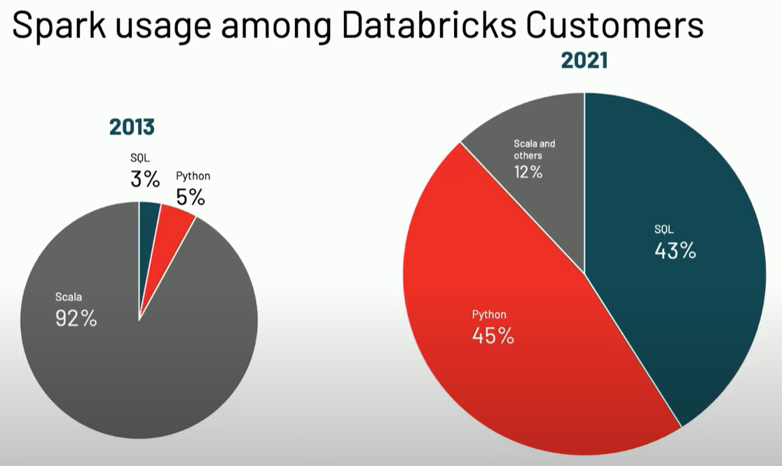
Spark Languages
Choice of programming language – no performance difference for most tasks

Slide 30
Enough Spark to Get Started

Slide 31
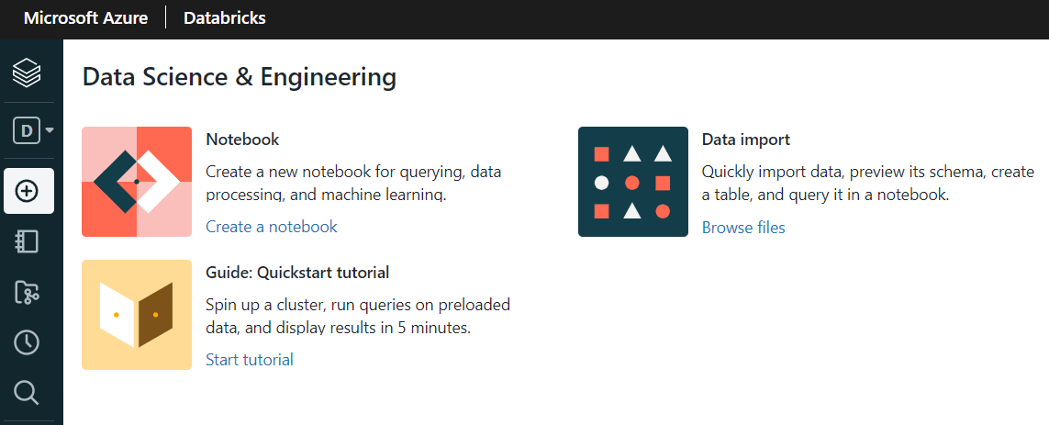
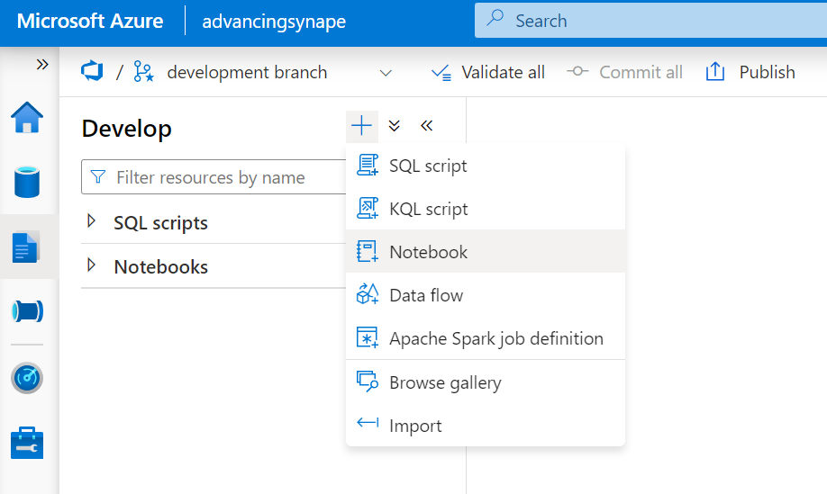
Spark is best in Notebooks

Slide 32
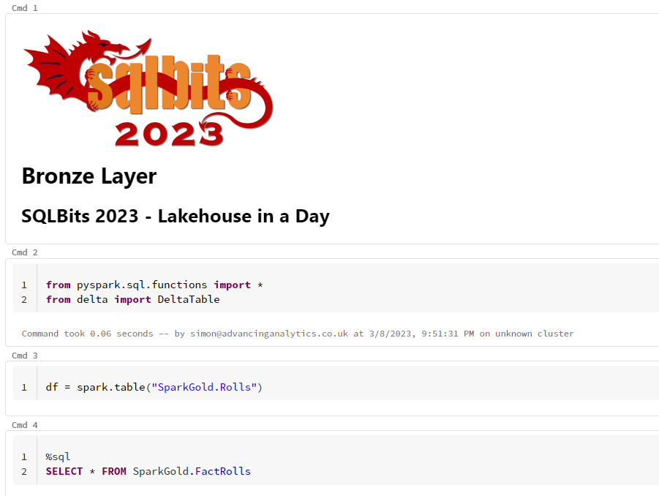
cells

Slide 33
Markdown basics
%md Indicates this cell is markdown
# H1 Header
## H2 Header
### H3 Header
#### H4 Header
*Italics* Make a in italics
**Bold** Make a word bold. <b>word</b> Also works.
You can use a mixture of Markdown and HTML
Markdown makes it easy for a developer to understand you code, if it is well annotated
Markdown helps a notebook tell a story

Slide 34
Databricks magic
%md – Markdown.
%fs - Databricks Utils File System (dbutils) commands.
%sh - Shell commands.
%python - Python. Use this when Python is not the default language
%scala - Scala. Use this when Scala is not the default language
%sql - SQL. Use this when SQL is not the default language
%r - R Language. Use this when R is not the default language
Magic allows you to change the language being used in a cell
Each cell can be different
We do not recommend this! Multi language notebooks are hard to maintain. Especially if you leave the company.
Variables from one languages are not available to another**
There is no %Java. Java needs to be deployed as a .jar

Slide 35
Synapse magic
%%pyspark - Python. Use this when Python is not the default language
%%spark - Scala. Use this when Scala is not the default language
%%sql - SQL. Use this when SQL is not the default language
%%csharp - R Language. Use this when R is not the default language
Notice that the magic commands are different for Synapse. If you use other Spark providers, they may be different again!

Slide 36
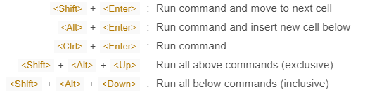
shortcuts
Just get very used to hitting CTRL + ENTER all the time!!

Slide 37
Notebooks need a Cluster
Your notebook code is associated to a Spark Cluster to be executed. Your cluster must be switched on!

Slide 38
What is a dataframe?
A Dataframe is not a table
A Dataframe is a set of instructions about how to produce a table of data. Think of it more like a query

Slide 39
What is a dataframe?
In order to query our data, we need to know:
Where the data is – our path
How the data is stored – our file format
What shape the data is in – our schema

Slide 40
Building a Dataframe
# Create a new DataFrame
df = spark.read.csv(“/mnt/training/samplecsv”)
# Add options
df = spark.read.option(“header”,True).csv(“/mnt/training/samplecsv”)
# Use Brackets for Multi-line commands
df = (spark
.read
.option(“header”,True)
.format(“csv”)
.load(“/mnt/training/samplecsv”)
)
display(df)
The latter two are identical in execution - but have different syntax. Get used to it!

Slide 41
Working with SQL
You can use SQL directly – although beware it is SparkSQL, not T-SQL! There are some minor syntax differences!
You can also mix python & SQL together
# Work with the table directly
%sql
SELECT * FROM NewTableName
# Create a new python dataframe using the SQL supplied
df = spark.sql(“SELECT * FROM NewTableName”)
# Create a new python dataframe using a full table (basically select *)
df = spark.table(“database.NewTableName”)

Slide 42
Writing to the data lake
We can write directly to the lake, but most tools are moving towards using SQL Objects directly. If we define a spark database, we can write it directly to that location.
# Create Database with Location
spark.sql(“CREATE DATABASE MyBronze LOCATION ‘abfss://lake@storage…’”)
# Write dataframe to SQL Catalog location
( df
.write
.format(“delta")
.saveAsTable(“MyBronze.SampleTable”)
)
# Write dataframe directly lake folder location
( df
.write
.format(“delta")
.save(“abfss://lake@lakestorage…”)
)

Slide 43
SparkSQL

Slide 44
Spark SQL Concepts
If the idea of spark.read() and dataframes leaves you uncomfortable, you can write pure SQL in Spark instead.
You can read files, create tables, apply changes in a merge statement and more – there’s no performance difference of sticking with SQL.
You do lose some flexibility, but for getting started it’s a great option!

Slide 45
Spark SQL Differences
It is worth noting that Spark SQL is NOT T-SQL, it’s probably closer to MySQL
Key differences:
Column Names with spaces are referenced as `Col Name` not [Col Name]
Instead of “SELECT TOP 10 * FROM A” it’s “SELECT * FROM A LIMIT 10”
ANSI standards are not enforced by default
Data Types are looser – think String not Varchar(25)
Some date functions are… weird
No Recursive CTEs

Slide 46
Read JSON using Spark SQL
We can use SQL to query flat files directly, or we can create temporary SQL objects and then use them in later queries
-- READ JSON INTO TEMPORARY TABLE
CREATE TEMPORARY VIEW sourceJSON
USING JSON
OPTIONS (path=“abfss://landing@lake…/mysourcefile.json")
We can supply many different options to help with reading different files, dealing with different charsets, formats and more

Slide 47
CreATING SQL OBJECTS
Spark has the concept of a SQL metastore baked in. We can create schema objects with a default lake location, then create tables directly within that location
-- CREATE AN EMPTY SCHEMA
CREATE SCHEMA bronze
LOCATION “abfss://landing@lake…/bronze/"
This is very useful for controlling the structure of the underlying lake, whilst still giving SQL users the ability to create objects as they need.

Slide 48
Writing Data with Spark SQL
Spark SQL can be used for many DDL statements, providing we are using Delta format.
A common approach for small tables is to use the CTAS approach
-- READ JSON INTO TEMPORARY TABLE
CREATE OR REPLACE TABLE bronze.mytable
AS
SELECT *
FROM sourceJSON
WHERE custID IS NOT NULL
USING DELTA
We don’t need to specify a location here as it will use the default location of the “bronze” schema

Slide 49
Data FlowS – No-Code Spark

Slide 50
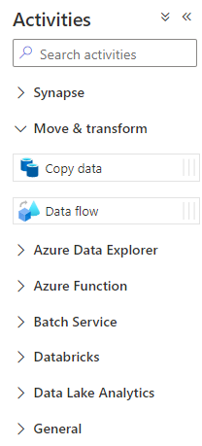
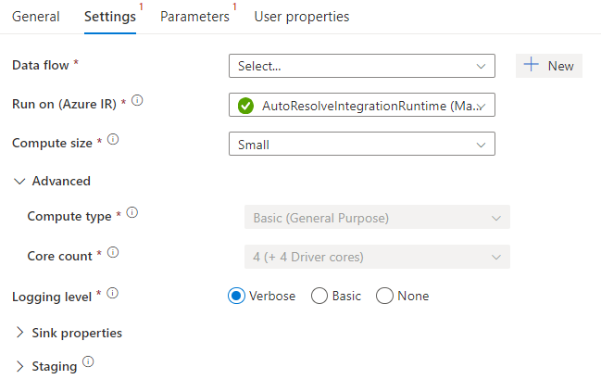
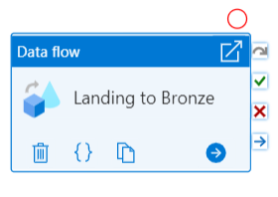
Creating Data Flows

Slide 51
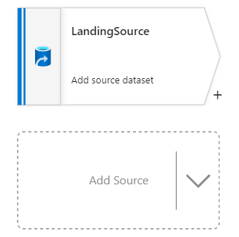
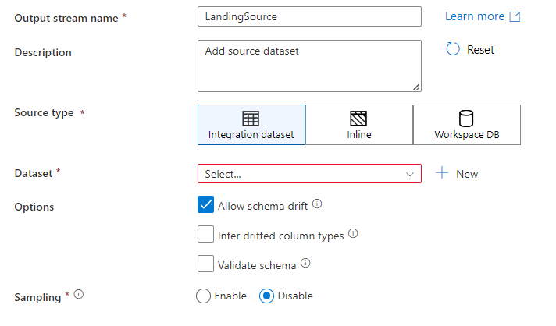
Data Flow Concepts - Sources

Slide 52
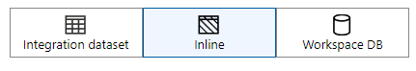
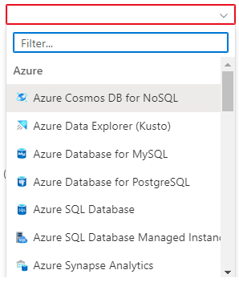
Data Flow Concepts - Sources

Slide 53
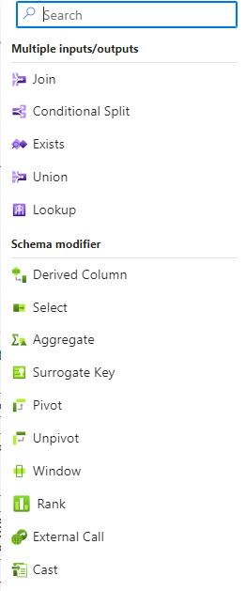
Data Flow Concepts - Transforms

Slide 54
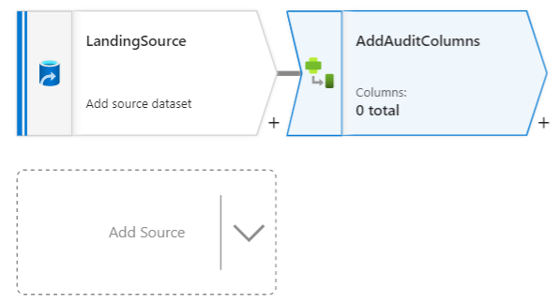
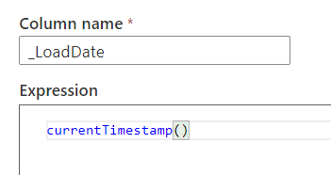
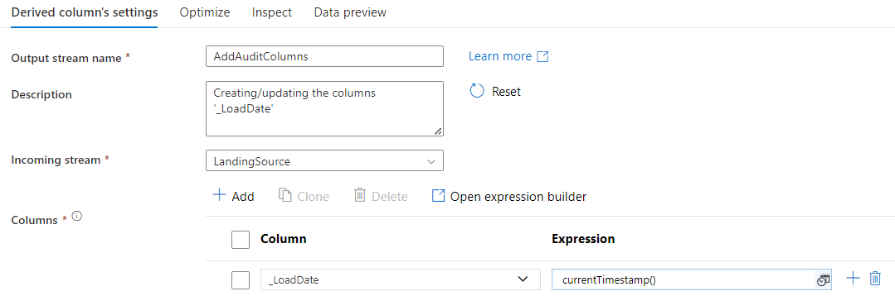
Data Flow Concepts - Transforms

Slide 55
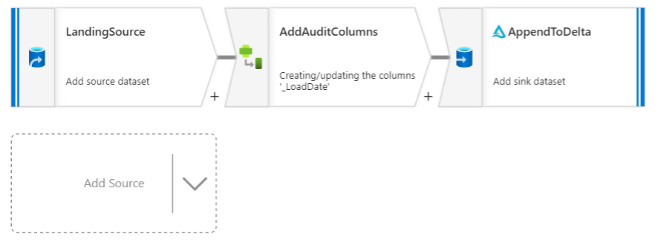
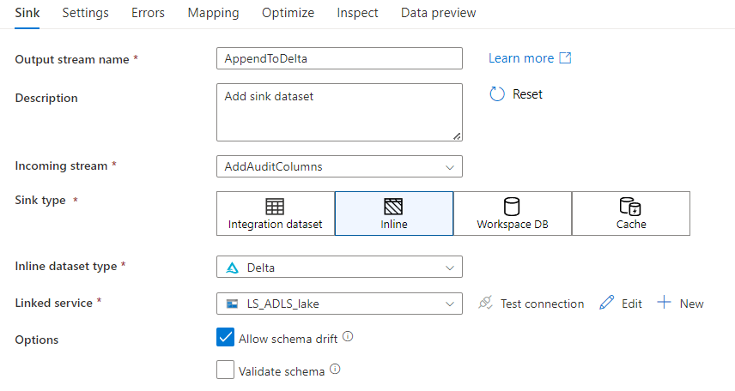
Data Flow Concepts - Transforms

Slide 56
Our Challenge – Transforming Data
Bronze
Silver
Gold

Slide 57
Bronze Layer

Slide 58
Our Challenge – Transforming Data
Bronze
APPEND
Source data in JSON format
Read files
Add audit/metadata columns
Insert directly into a Bronze Delta Table

Slide 59
Landing to Bronze Recaps

Slide 60

Any Questions raised during the build?
Best Questions from Coaches?
Questions now?

Slide 61
Silver Layer

Slide 62
Our Challenge – Transforming Data
Bronze
Silver
CLEAN & MERGE
Read from Delta Bronze Layer
Apply Data Cleansing
Filter Bad Rows
Merge into Delta Silver Layer

Slide 63
Bronze to Silver Recaps

Slide 64
Any Questions raised during the build?
Best Questions from Coaches?
Questions now?

Slide 65
Gold Layer

Slide 66
Our Challenge – Transforming Data
Silver
Gold
CLEAN & MERGE
Read from Delta Silver Layer
Transform into Dimensional Model
Merge into Delta Gold Layer
Decide how to separate different Gold tables

Slide 67
Silver to Gold Recaps

Slide 68
Any Questions raised during the build?
Best Questions from Coaches?
Questions now?

Slide 69
Serving Data

Slide 70
Orchestration

